Slide 1
Optical Network Elements
Chapters 1&2
J. M. Simmons, Optical Network Design and Planning, Optical Networks,
© Springer International Publishing 2014

Slide 2
Lecture agenda:
Basic optical network components
Optical networks with solely Electronical processing at their nodes with optical terminal
Optical add/drop multiplexer (OADM)
Multi-degree OADM (OADM-MD)
Reconfigurable OADMs, or ROADMs:
Broadcast-and-select
Route-and-select
Wavelength-selective
Colorless, directionless, contentionless, and gridless ROADMs

Slide 3
Network layers and Topologies
The optical layer is based on wavelength division multiplexing ( WDM) technology with configurable optical switches.
Virtual topology
Physical topology

Slide 4
Network Interfacing
Commonly used SONET/ SDH signal rates
OTN transport rate hierarchy
OTN switching/ multiplexing rate hierarchy

Slide 5
Network ingredients
Nodes are represented by circles, and links are represented by solid lines. Nodes A and B have a degree of two, Node C has a degree of three, and Node D has a degree of one

Slide 6
Network ingredients, cont’d
Traffic: The collection of services that must be carried.
Demand: An individual traffic request.
Demands are between two nodes and are bidirectionally symmetric = if there is a traffic request from Node A to Node B, then there is an equivalent traffic from Node B to Node A.
In any one direction, the originating node is called the source and the terminating node the destination.
In multicast applications, the demands have one source and multiple destinations; such demands are typically one-way only.
Connection: The path allocated through the network for carrying a demand.
Provisioning: The process of deploying and configuring the equipment to support a demand or turning up, the connection.

Slide 7
Transponders
1310 nm transmitter/ receiver and a WDM-compatible transmitter/ receiver to convert between a 1310 nm signal and a WDM-compatible signal.

Slide 8
Example of an optical-terminal
The transponder converts the signal to a WDM- compatible optical frequency, typically in the 1500-nm range of the spectrum.
The 1310-nm signal is referred to as gray optics, to emphasize that the client signals are nominally at the same frequency, in contrast to the different frequencies (or colored optics) comprising the WDM signal.
An optical terminal is deployed with
equipment shelves in which the
transponders are inserted.
Density of the transponders
Pay-as-you-grow
Slots flexibility (colorless slot)

Slide 9
Transponders, cont’d
In fixed-tuned transponders, the client signal can be converted to just one particular optical frequency.
In transponders equipped with tunable lasers, the client signal can be converted to any one of a range of optical frequencies.
While there is a small cost premium for tunable transponders as compared to fixed transponders, they greatly improve the flexibility of the network as well as simplify the process of maintaining inventory and spare equipment for failure events.

Slide 10
Two basic terms
Majority of traffic
entering a node is
being routed through
the node to its final
destination
Transiting traffic
remain
in optical domain
Significant reduction in
required nodal electronic
equipment
Optical bypass
Optical Reach ≡ Transparent reach: The distance an optical signal can
travel before it degrades to a level that can not be regenerated.

Slide 11
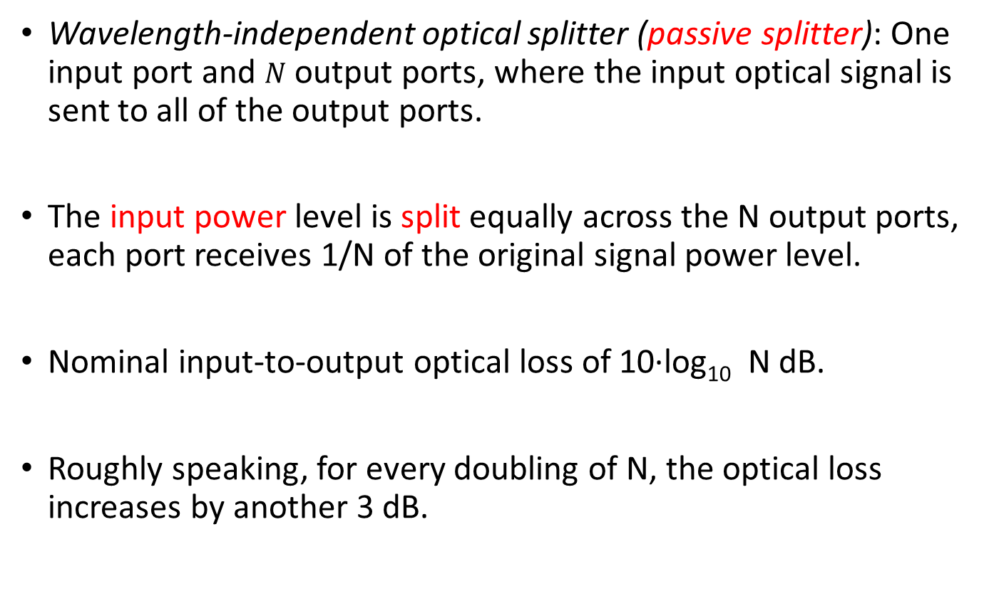
Passive Splitter and combiner
Wavelength-independent optical splitter (passive splitter): One input port and $N$ output ports, where the input optical signal is sent to all of the output ports.
The input power level is split equally across the N output ports, each port receives 1/N of the original signal power level.
Nominal input-to-output optical loss of 10·log₁₀ N dB.
Roughly speaking, for every doubling of N, the optical loss increases by another 3 dB.

Slide 12
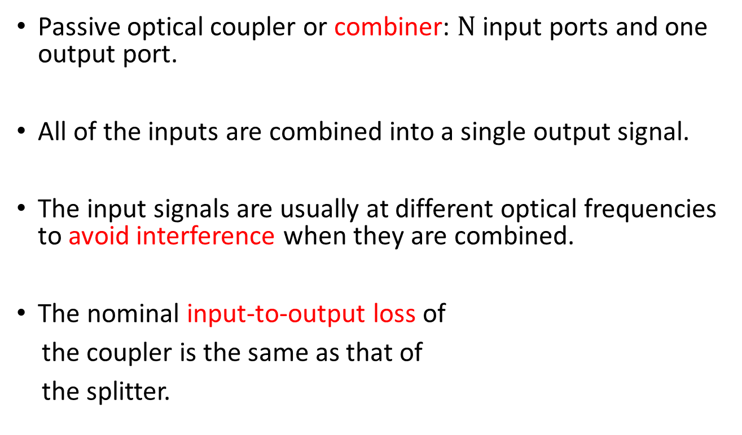
Passive Splitter and combiner, cont’d
Passive optical coupler or combiner: $N$ input ports and one output port.
All of the inputs are combined into a single output signal.
The input signals are usually at different optical frequencies to avoid interference when they are combined.
The nominal input-to-output loss of
the coupler is the same as that of
the splitter.

Slide 13
1 × N demultiplexer & N × 1 multiplexer,
Demultiplexer: WDM signal on the input line is demultiplexed into its constituent wavelengths, with a separate wavelength sent to each output port.
Multiplexer: N input ports and one output port, where the wave
Demultiplexers and multiplexers may
be built, for example, using
arrayed wave-guide grating (AWG)
technology or Wavelength grating
router (WGR).
For large N, the loss through an AWG is
on the order of 4–6 dB.

Slide 14
Wavelength-selective switch (WSS)
1 × N wavelength-selective switch (WSS) can direct any wavelength on the one input port to any of the N output ports.
It is typically not possible to multicast a given wavelength from one input port to multiple output ports, nor is it typically possible for multiple input ports to direct the same wavelength to one output port.
An N × 1 WSS performs a multiplexing
function.
Micro-electro-mechanical-system (MEMS)
technology uses tiny movable mirrors to
direct light from input ports to output ports.

Slide 15
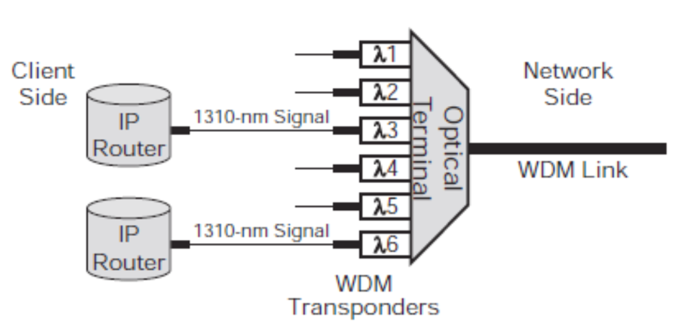
Optical Terminal
There are individual wavelengths on the client side of the terminal and a WDM signal on the network side.
Both IP routers transmit a 1310-nm signal that is received by a WDM transponder.

Slide 16
Optical Terminal, cont’d
Each link has the two directions of traffic.
The WDM transponder encompasses both a client-side receiver/network-side transmitter in one direction and a network-side receiver/client-side transmitter in the other direction.
The optical terminal is composed of both a multiplexer and a de-multiplexer.

Slide 17
Optical-terminal architectures
Colorless
Colored

Slide 18
Optical-Electrical-Optical (O-E-O) Architectures
O-E-O Architecture at Nodes of Degree-Two

Slide 19
Optical-Electrical-Optical (O-E-O) Architectures
O-E-O Architecture at Nodes of Degree-Three or Higher

Slide 20
O-E-O architecture with electronic switch fabric

Slide 21
Advantages of the O-E-O Architecture
Cleans up: The O-E-O process reamplifies, reshapes, and retimes the signals, a process that is known as 3R-regeneration, signals undergo degradation as they are transmitted along a fiber.
Performance monitoring of the signal
O-E-O architecture is very amenable to a multivendor architecture because all communication within a node is via a standard 1,310-nm optical signal.
Flexibility when assigning wavelengths to the traffic that passes through a node ≡ wavelength conversion

Slide 22
Disadvantages of the O-E-O Architecture
Challenges in scaling this architecture to larger networks. For example, with 100 wavelengths per fiber, this architecture potentially requires several hundred transponders at a node. => Cost, Physical space at the sites, more transponders more shelves, power consumption, and heat dissipation
Electronics are often tied to a specific technology = a great deal of equipment, including transponders and any electronic switches, needs to be replaced.
Provisioning a connection can be cumbersome in the O-E-O architecture. A technician may need to visit every node along the path of a connection to install the required transponders
Reliability issue of the OEO equipment

Slide 23
Optical bypass: all-optical or transparent
The OADM, that allow the through traffic to remain in the optical domain as it transits the node;
Transponders are needed only for the add/drop traffic and the through traffic is said to optically bypass the node.
Over 50 % of the traffic entering a node is through traffic; thus, a significant amount of transponders can be eliminated with optical bypass.
Other terms used in the literature to describe this type of network are “all-optical” or “transparent.”
Translucent: Networks supporting optical bypass while still requiring some electronic regeneration.

Slide 24
Advantages of Optical Bypass
Optical-bypass technology is potentially more scalable in cost, space, power, and heat dissipation
Optics is more agnostic to the wavelength line rate as compared to electronics.
Provisioning a connection is operationally simpler.
Elimination of much of the electronics also improves the overall reliability.

Slide 25
Disadvantages of Optical Bypass
The optical signal of the through traffic is not regenerated, thereby requiring extended optical reach.
No node-by-node error-checking functionality they provided (no electronic performance monitoring)
Challenging to support a multivendor environment in an optical-bypass-enabled network because not all intra-nodal traffic is converted to a standard optical signal as it is in an O-E-O network.

Slide 26
Disadvantages of Optical Bypass, cont’d
Single vendor providing both the transmission system and the optical networking elements => “islands of transparency,” designated vendors operate within non-overlapping subsets of the network
No opportunity for wavelength conversion as with the O-E-O architecture. The wavelength continuity constraint is the major reason why advanced algorithms are required to efficiently operate a network based on optical-bypass technology.

Slide 27
OADM
OADMs have been commercially available since the mid-1990s, although significant deployment did not start until after 2000.

Slide 28
OADM Reconfigurability ≡ ROADM
The earliest commercial OADMs were not configurable.
Carriers needed to specify up front which particular wavelengths would be added/dropped at a particular node, with all remaining wavelengths transiting the node.
The OADM was fixed in that configuration. Clearly, this rigidity limits the ability of the network to adapt to changing traffic patterns. Such OADMs are sometimes referred to as fixed OADMs, or FOADMs.
ROADM: Any wavelength can be added/dropped at any node and remotely configurable through software as opposed to requiring manual intervention.
Solution

Slide 29
Multi-degree ROADMs (ROADM-MD)
Interconnected-ring and mesh topologies have a degree greater than two
US backbone networks
US metro-core networks with interconnected-ring topologies
US metro-core networks with mesh topologies

Slide 30
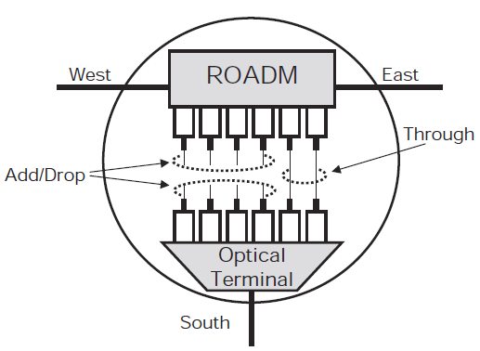
Multi-degree ROADMs (ROADM-MD), cont’d
ROADM-4D = two ROADM-2Ds
ROADM-2D + Optical Terminal
ROADM-3D

Slide 31
ROADM Architectures
Optically bypassing several consecutive nodes
Broadcast-and-select
Route-and-select
Wavelength-selective

Slide 32
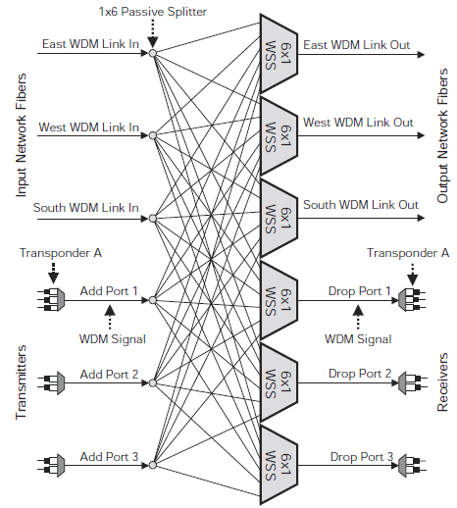
Broadcast-and-select ROADM
Supports multicast in the optical domain
Drop-and- continue function
Protection against failures

Slide 33
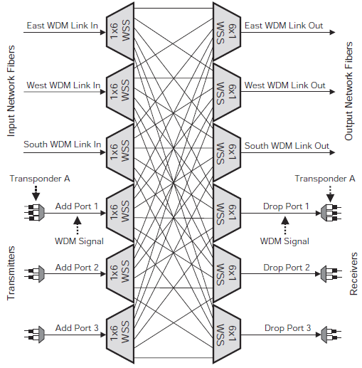
Route-and-select ROADM
The cost of the network element almost doubles.
Multicast is not supported

Slide 34
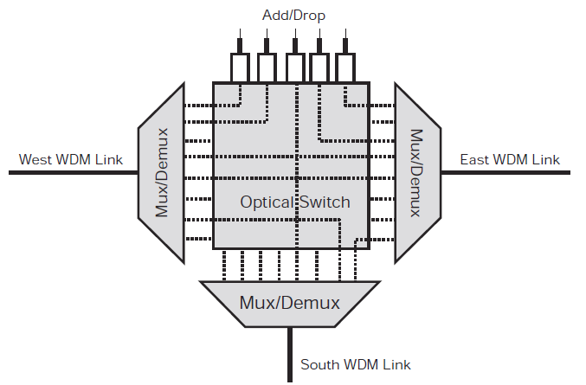
Wavelength-selective

Slide 35
ROADM Properties
To be studied optionally:
Colorless
Directionless
Contentionless
Gridless

Slide 36
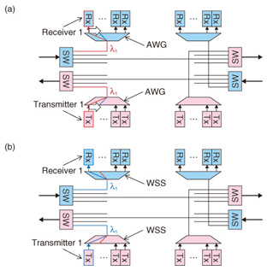
Colorless Switching
Any wavelength can be dynamically
added/dropped without having to
re-fiber a transceiver.
Optical Communications Network

Slide 37
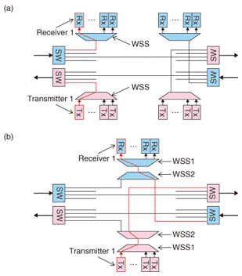
Directionless switching
A wavelength can be dynamically
added/dropped from any direction
without having to re-fiber a
transceiver.
Optical Communications Network

Slide 38
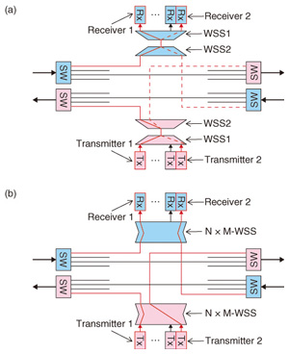
Contentionless Switching
A wavelength can be re-used on
all directions without any
restrictions.
Check out more details at:
http://slideplayer.com/slide/3256341/

Slide 39
Enough for today!
Questions?

